Slide 1
First- and Last-Touch Attribution Project
Learn SQL from Scratch
Matt Becker
1/4/2019

Slide 2
Table of Contents
Get familiar with CoolTShirts ---------------------------------------------- slides 3-6
What is the user journey? -------------------------------------------------- slides 7-13
Optimize the campaign budget ------------------------------------------- slide 14

Slide 3
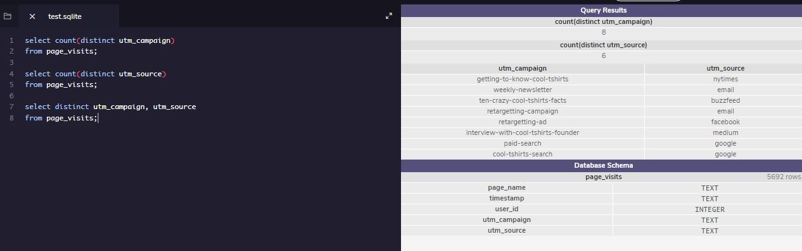
Get familiar with CoolTShirts - Task 1
How many campaigns and sources does CoolTShirts use? Which source is used for each campaign?

Slide 4
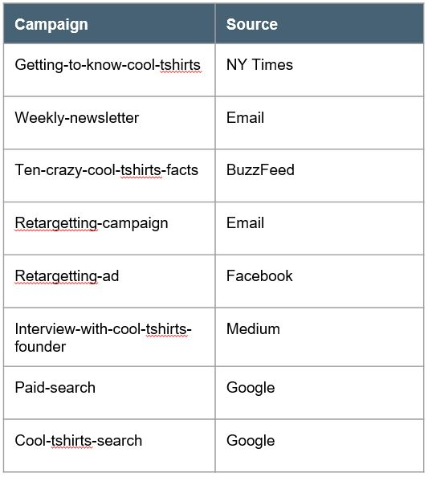
Get Familiar With CoolTShirts
How many campaigns and sources does CoolTShirts use and how are they related?
CoolTShirts uses 8 campaigns and 6 sources.
The utm_campaign identifies the specific ad or email blast and utm_source identifies which site sent the traffic.

Slide 5
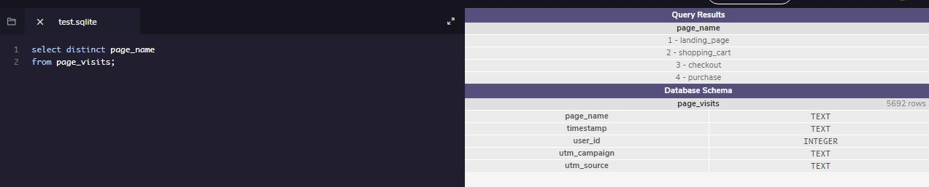
Get familiar with CoolTShirts - Task 2
What pages are on the CoolTShirts website?

Slide 6
Get Familiar With CoolTShirts
What pages are on their website?
There are 4 pages on the CoolTShirts website. The pages are as follows:
1 - landing_page
2 - shopping_cart
3 - checkout
4 - purchase

Slide 7
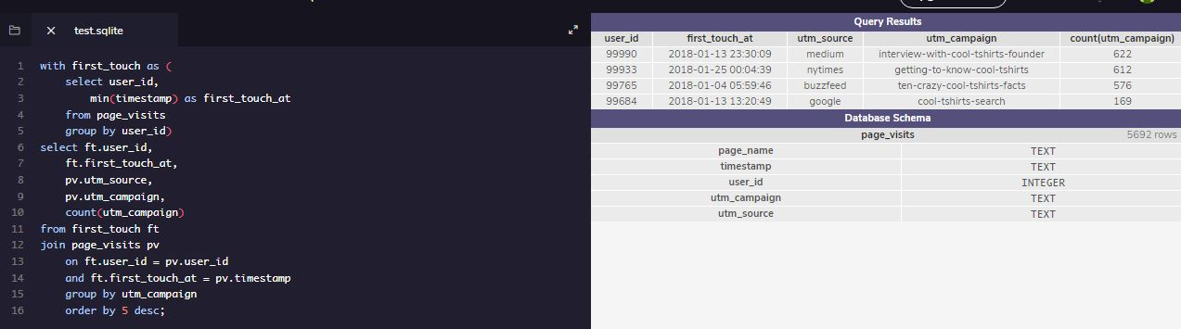
What is the user journey? - Task 3
How many first touches is each campaign responsible for?

Slide 8
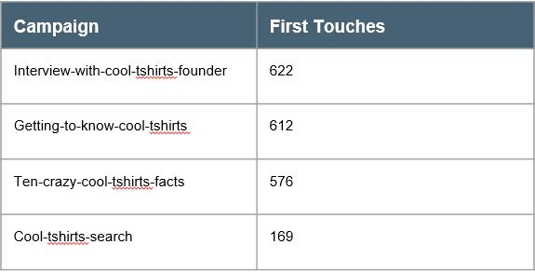
What is the user journey?
How many first touches is each campaign responsible for?
The ‘interview-with-cool-tshirts-founder’ campaign was responsible for the most First Touches with 622.
The ‘getting-to-know-cool-tshirts’ and ‘ten-crazy-cool-tshirts-facts’ campaigns were close behind with 612 and 576 respectively.
Of all the campaigns that contributed First Touches the ‘cool-tshirts-search’ campaign was last with 169.

Slide 9
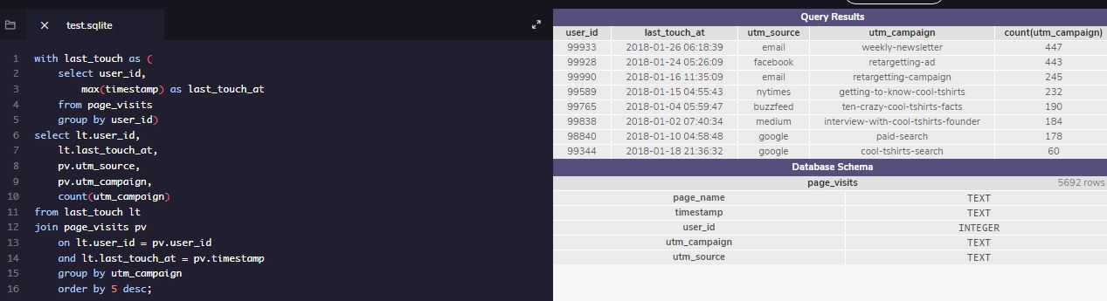
What is the user journey? - Task 4
How many last touches is each campaign responsible for?

Slide 10
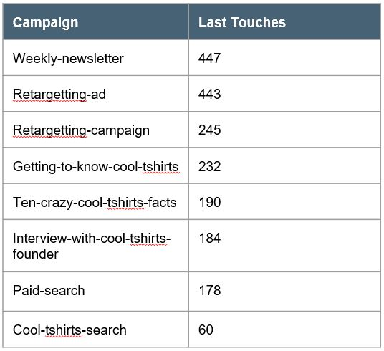
What is the user journey?
How many last touches is each campaign responsible for?
The ‘weekly-newsletter’ was responsible for the most Last Touches with 447. Closely followed by the ‘retargetting-ad’ with 443.
The ‘cool-tshirts-search campagin’ was responsible for the fewest Last Touches with only 60.

Slide 11
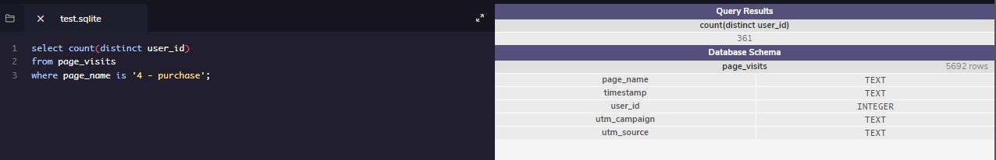
What is the user journey? - Task 5
How many visitors make a purchase?
361 visitors made a purchase.

Slide 12
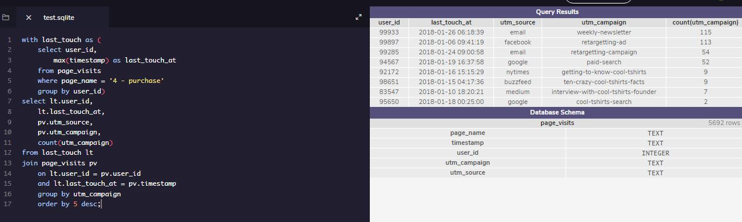
What is the user journey? - Task 6
How many last touches on the purchase page is each campaign responsible for?

Slide 13
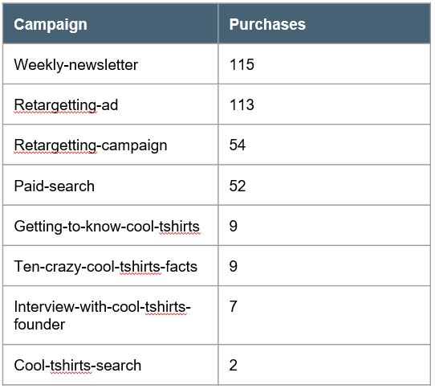
What is the user journey?
How many last touches on the purchase page is each campaign responsible for?
The ‘weekly-newsletter’ campaign is responsible for the most purchases, closely followed by the ‘retargetting-ad’ campaign. The ‘cool-tshirts-search’ campaign is responsible for the fewest purchases.
What is the typical user journey?
The majority of users came in through the ‘interview-with-cool-tshirts-founder’ campaign and purchased through the ‘weekly-newsletter’ campaign.

Slide 14
Optimize the campaign budget
CoolTShirts can re-invest in 5 campaigns. Which should they pick and why?
These are the 5 campaigns CoolTShirts should re-invest in:
Interview-with-cool-tshirts-founder
Getting-to-know-cool-tshirts
Ten-crazy-cool-tshirts-facts
Weekly-newsletter
Retargetting-ad
Over 90% of their First Touches come through one of the following three campaigns: ‘interview-with-cool-tshirts-founder’, ‘getting-to-know-cool-tshirts’ or ‘ten-crazy-cool-tshirts-facts’
Over 60% of their Purchases come through one of the following two campaigns: ‘weekly-newsletter’ or ‘retargetting-ad’
The majority of CoolTShirts purchases come through campaigns that are sent to existing users but in order for those campaigns to be successful it is important for them to generate new users. That is why they should focus on their top-three First Touch campaigns, since there is a large drop off after that, and then their top-two Last Touch campaigns as well since there is also a large drop off after that.

